Slide 1

Chapter -3
Examples

Slide 2
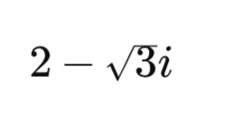
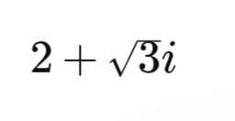




Example 3.8
Given root:
Since coefficients are real, the
conjugate root is also a root.
Form the polynomial.
Find sum of roots.
Find product of roots.

Slide 3




Answer -

Slide 4



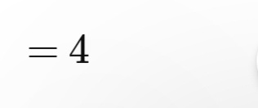
Example 3.9
Given root:
Since coefficients are rational
is also a root.
Find sum of roots.

Slide 5




Find product of roots.
Use
Answer-

Slide 6





Example 3.10
Let
Square both sides.
Multiply by √3.
Answer -

Slide 7




Example - 3.11
Compare with the standard form
Therefore,
Find the discriminant.

Slide 8


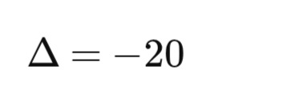
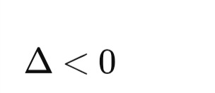
Substitute the values.
Simplify.
the equation has no real roots.
Answer -
No real solution

Slide 9
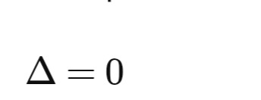

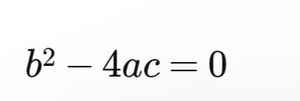



Example - 3.12
For equal roots,
Identify a,b,c
Apply the discriminant formula.
Substitute values.
Expand.

Slide 10




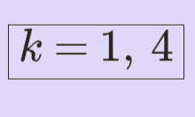

Divide by 4.

Slide 11

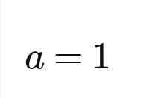
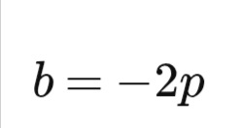

Example - 3.13
Given equation
Identify

Slide 12





Find the discriminant.
Substitute values.
Expand
Take common factor.
Write as a perfect square.
Since p,q,r are rational,2(q-r) is rational.
Answer-
Roots are rational.

Slide 13



Example 3.14
Let the equation of the circle be
Let the equation of the line be
Substitute y of line in circle equation

Slide 14



Expand the square term
Bring all terms to one side
Combine like terms
A quadratic equation can have at most two solutions.
For each value of x, we get a corresponding value of y using
Y=mx+c.Hence, there can be at most two points of intersection.

Slide 15
Therefore, a straight line and a circle can have at most two common points.
A line cannot intersect a circle at more than two points.
Hence Proved.

